Slide 1
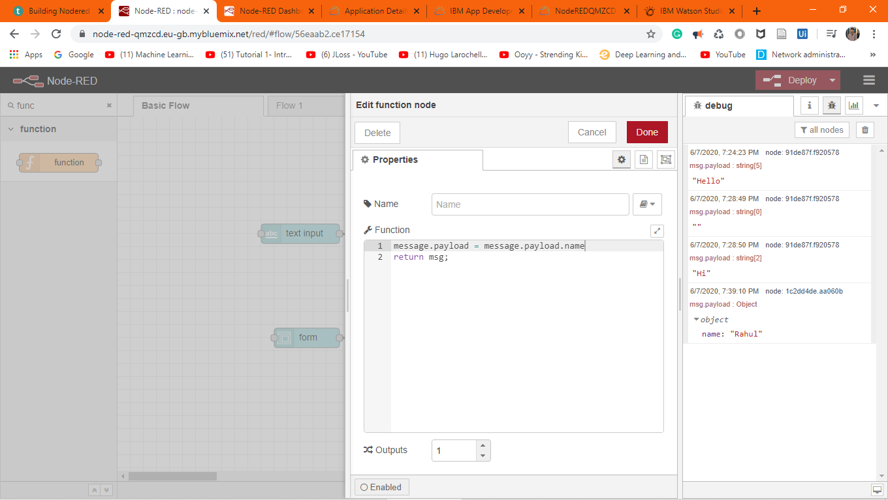

Slide 2
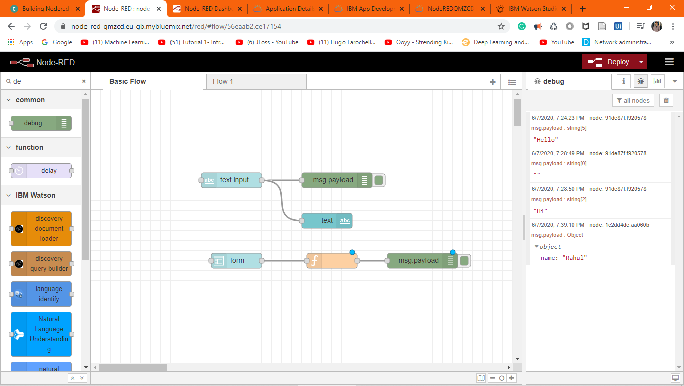

Slide 3
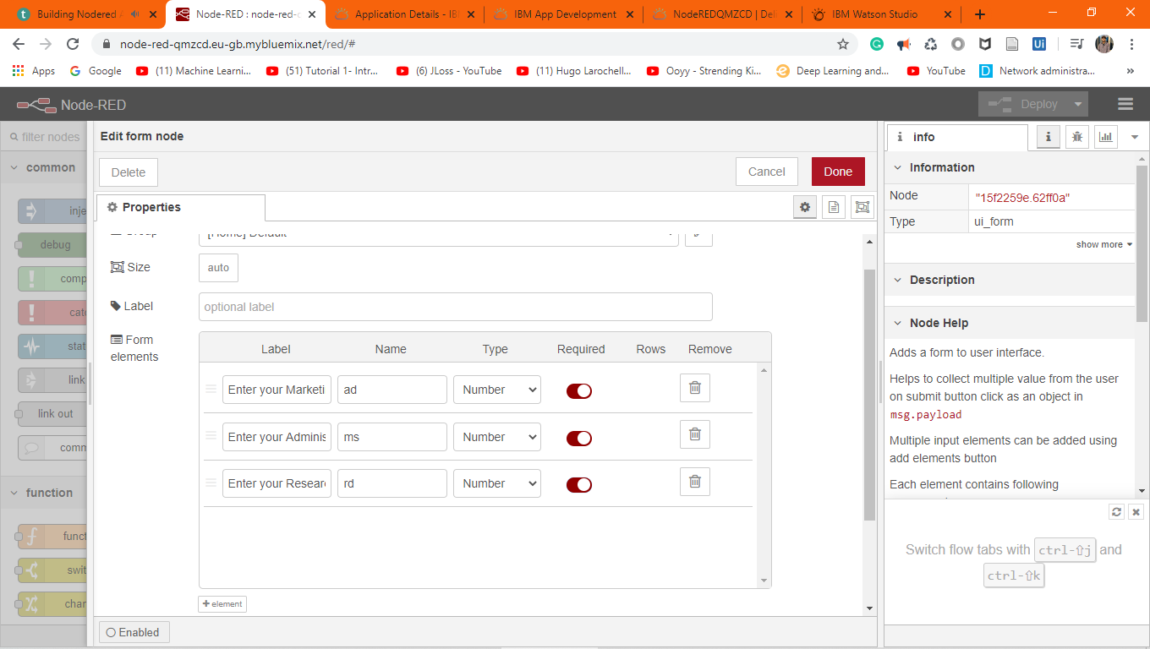

Slide 4
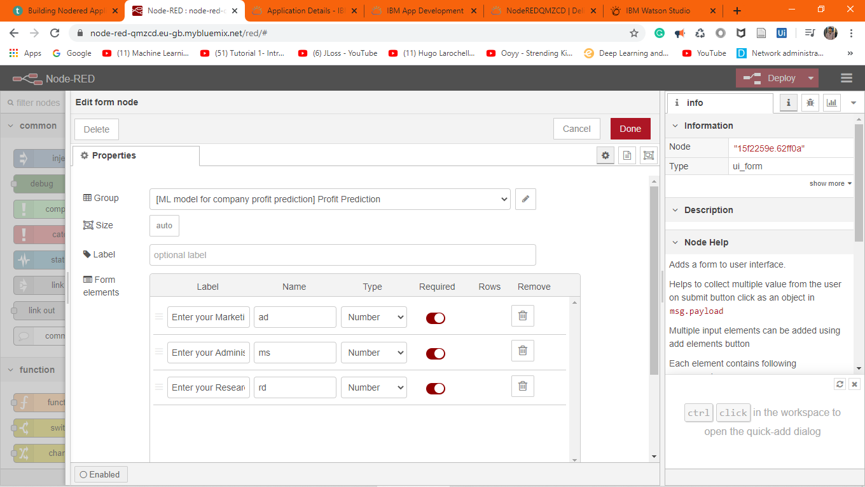

Slide 5
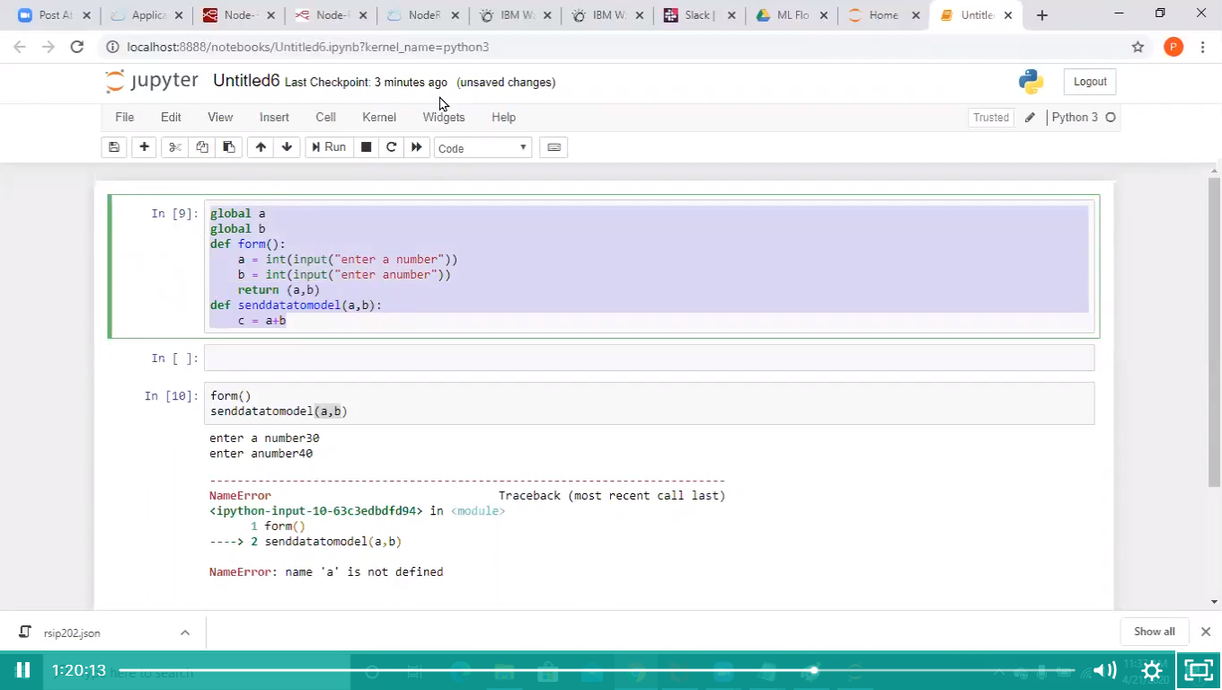
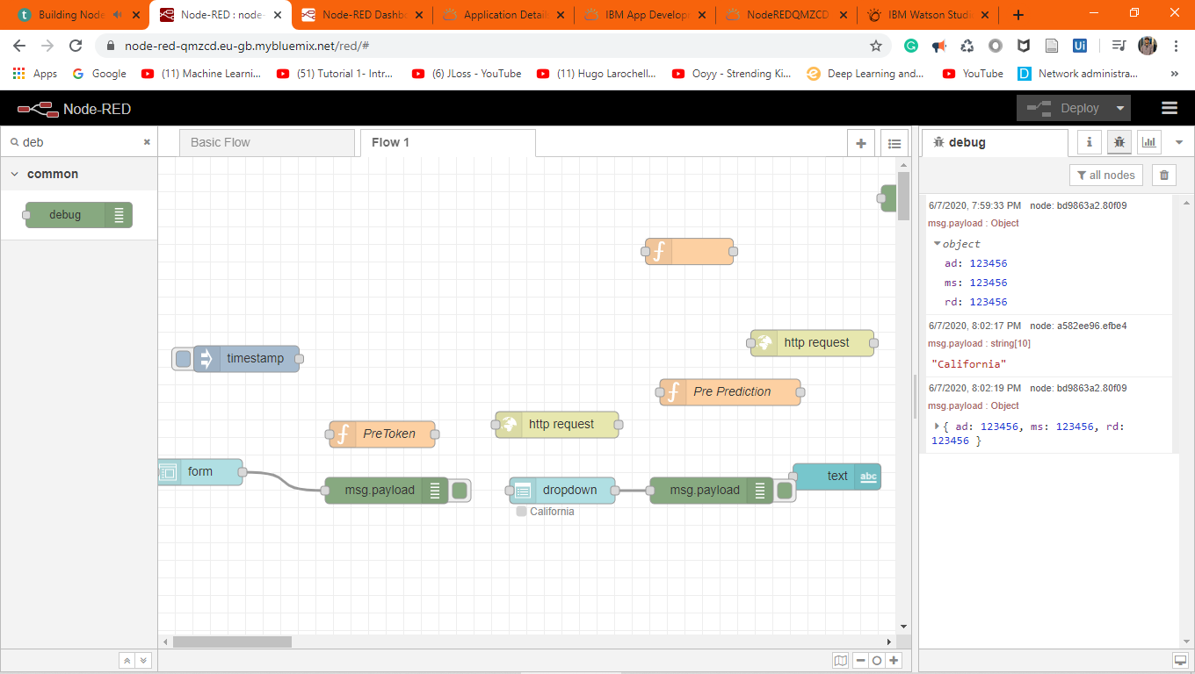
Notes:
Step 1 Completed

Slide 6
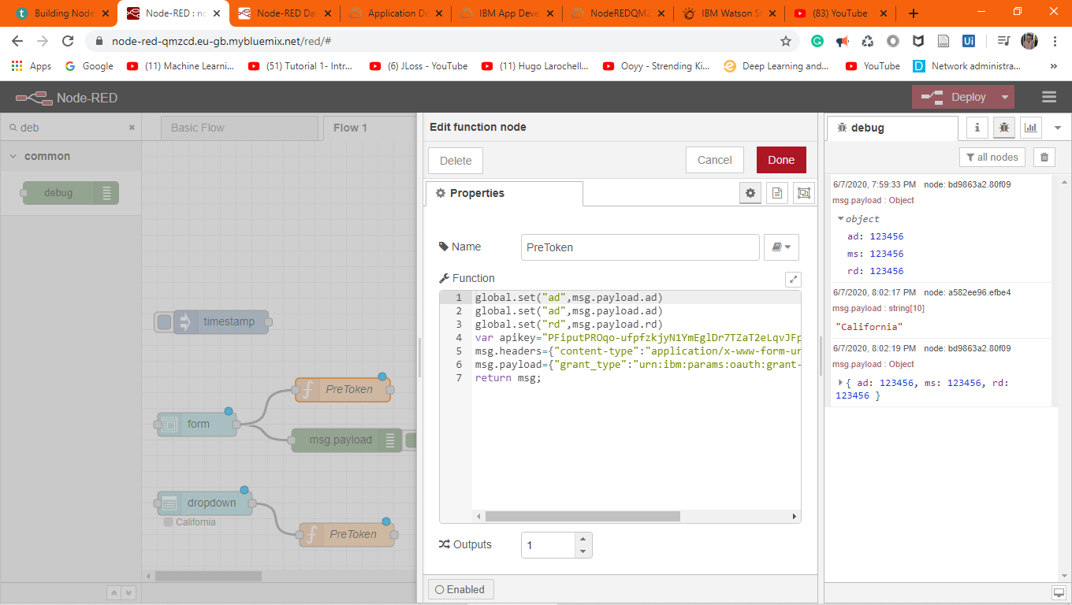
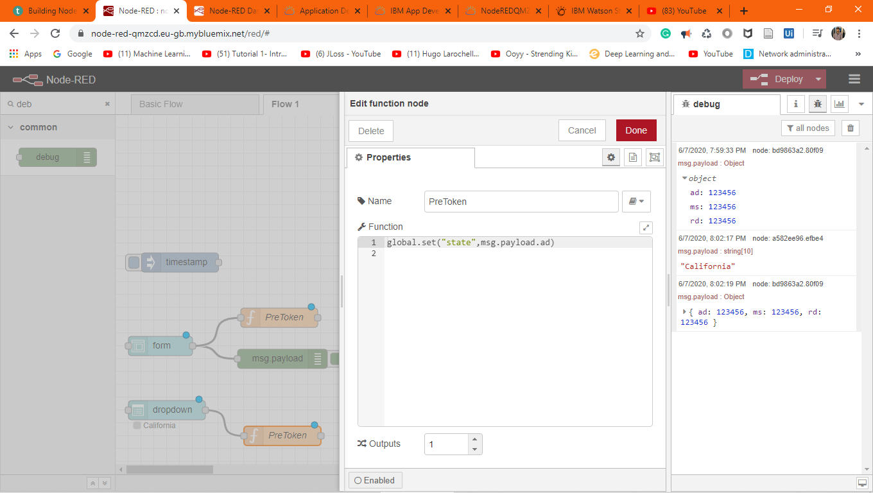
Notes:
Step 2 - We have to send the inputs to the scoring end point. Make variables global for the accessing.

Slide 7
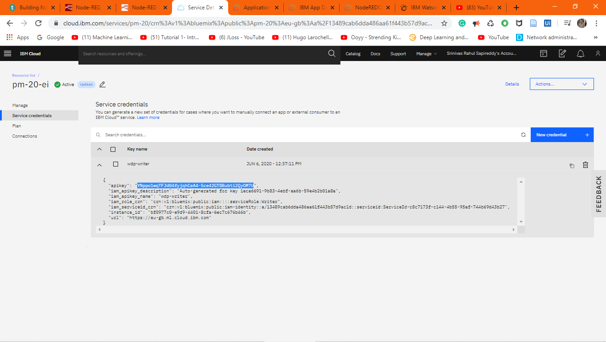
Notes:
Step 3 - http request to get the ml access token. You need to have the access from the ml service. ML Password can be considered as API Key and instant ID.
We are getting this API key from the ML Service.

Slide 8
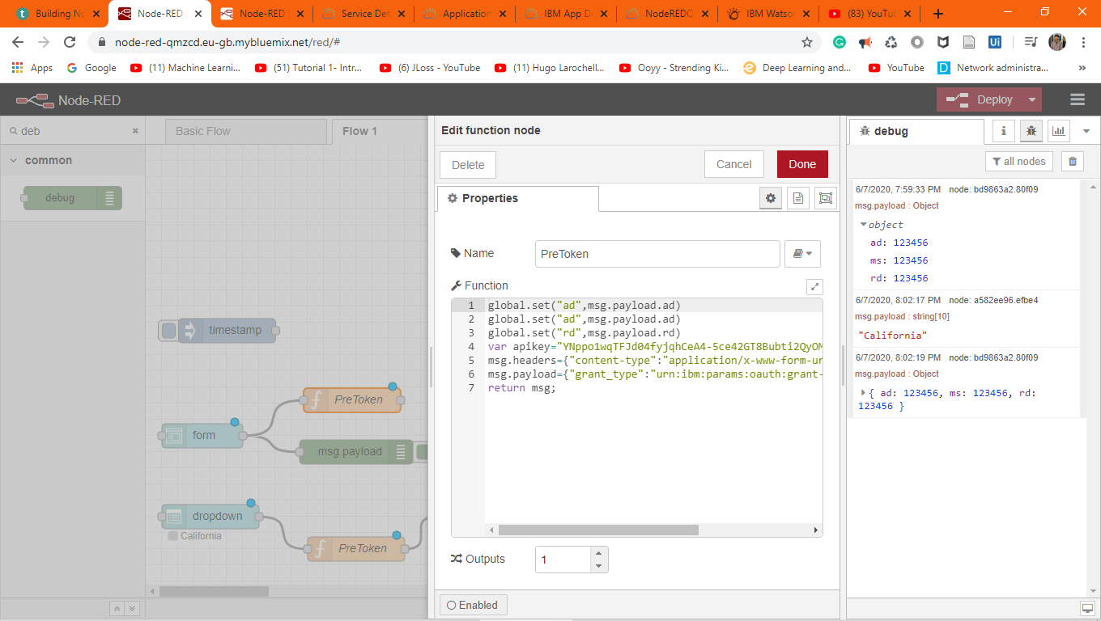

Slide 9
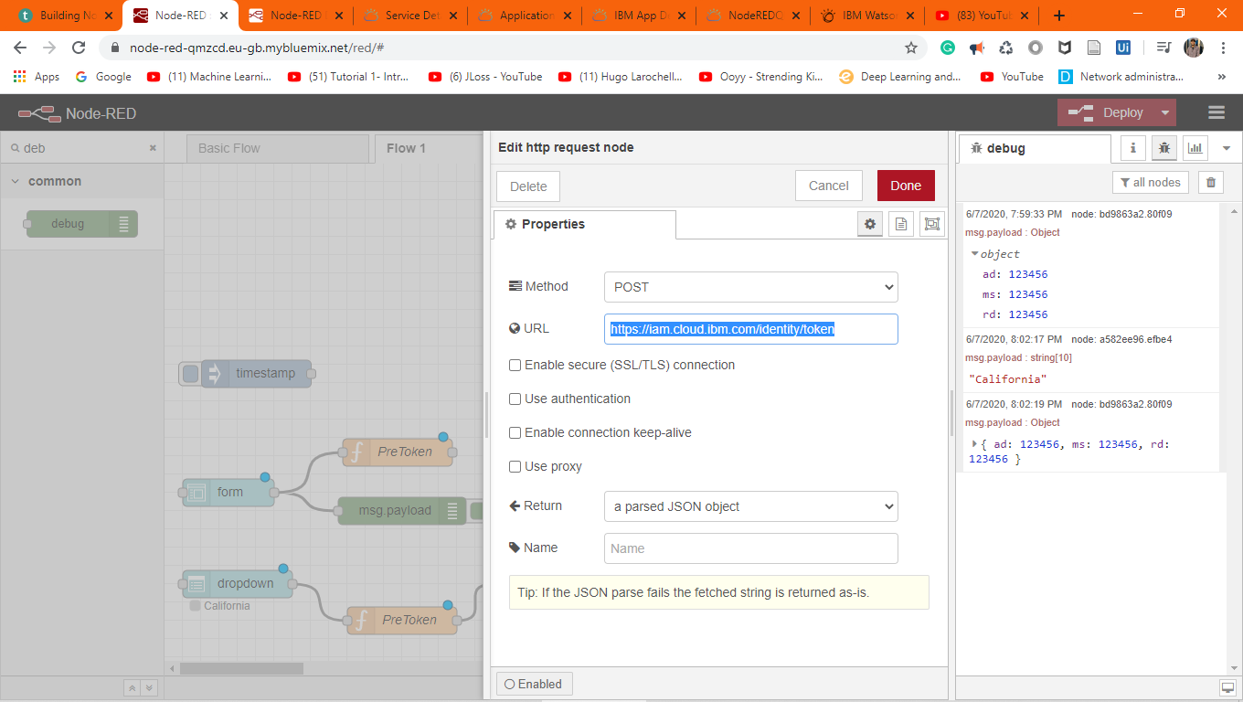

Slide 10
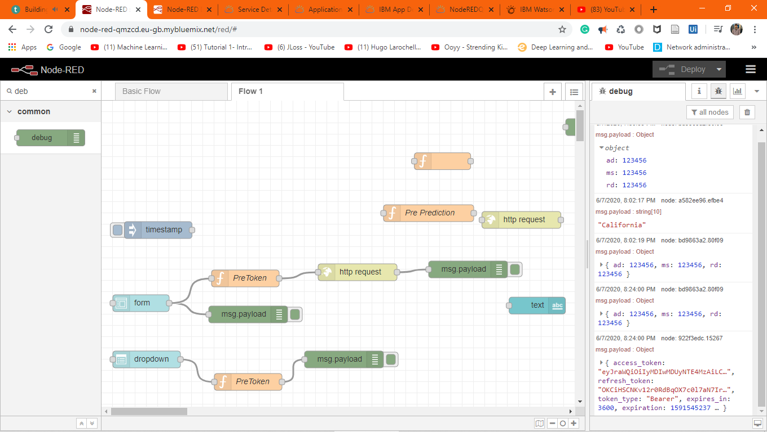
Notes:
Everytime you want to connect to ML deployment you have to generate an OTP in the form of access token.

Slide 11
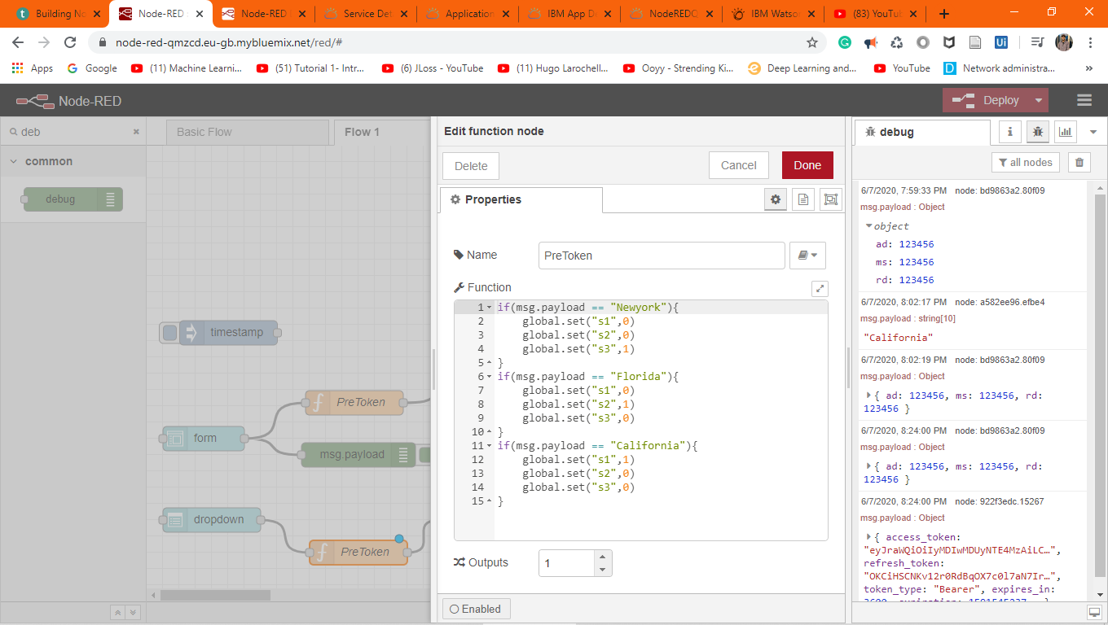
Notes:
Step 5 - Using http node, request the scoring endpoint along with the inputs and the access token.

Slide 12
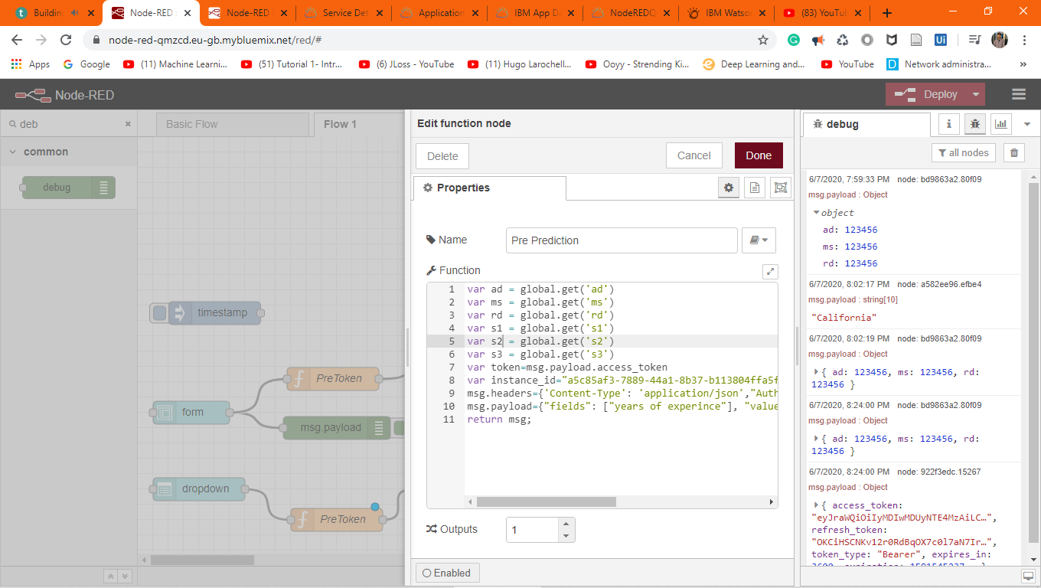

Slide 13
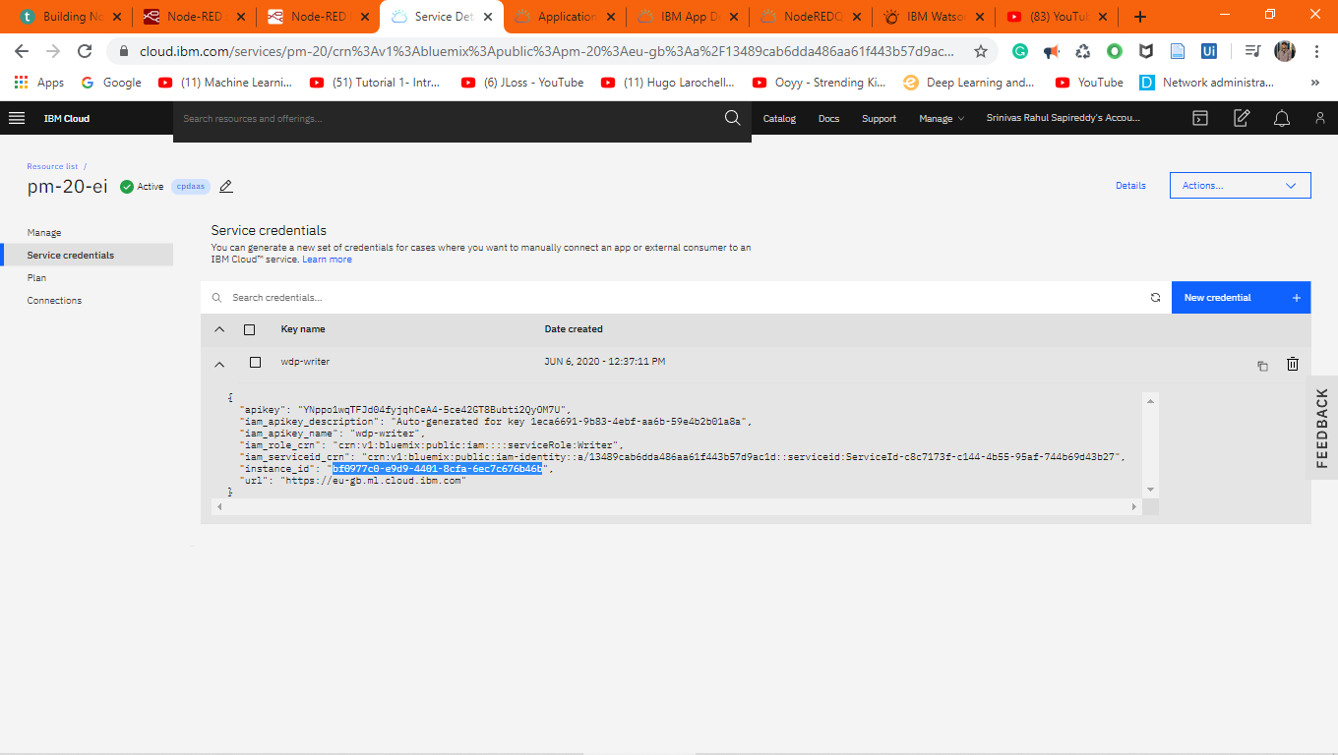
Notes:
To request a scoring end point you should have scoring end point and instance id.

Slide 14
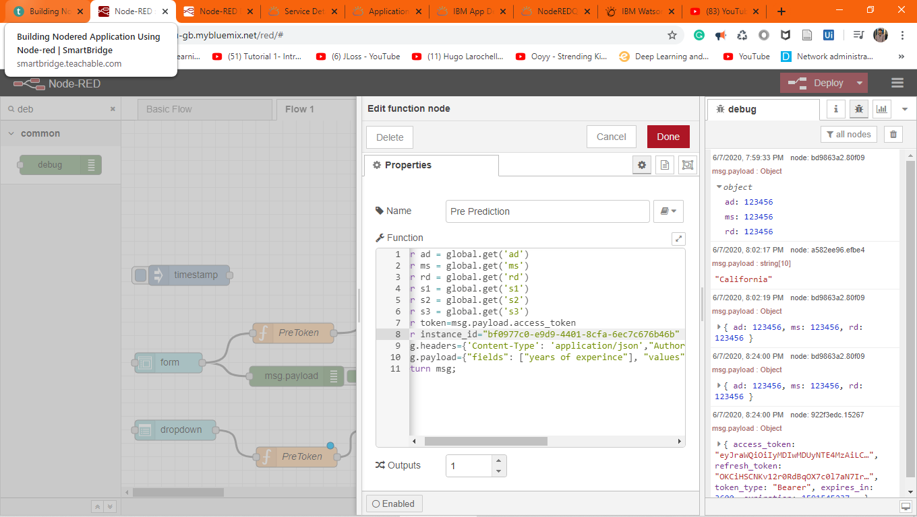

Slide 15
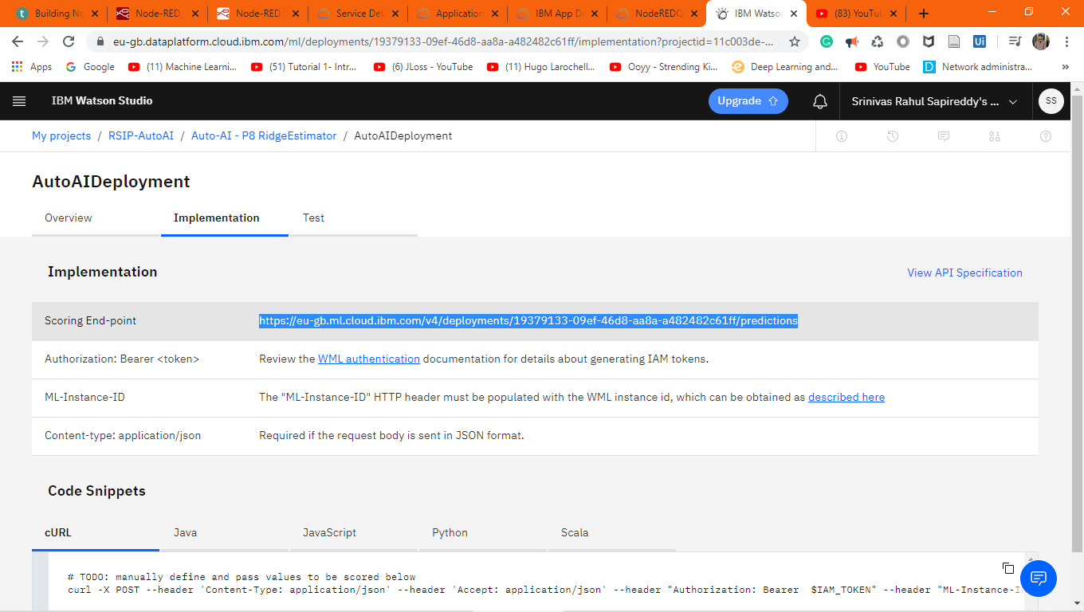
Notes:
Use this scoring end-point

Slide 16
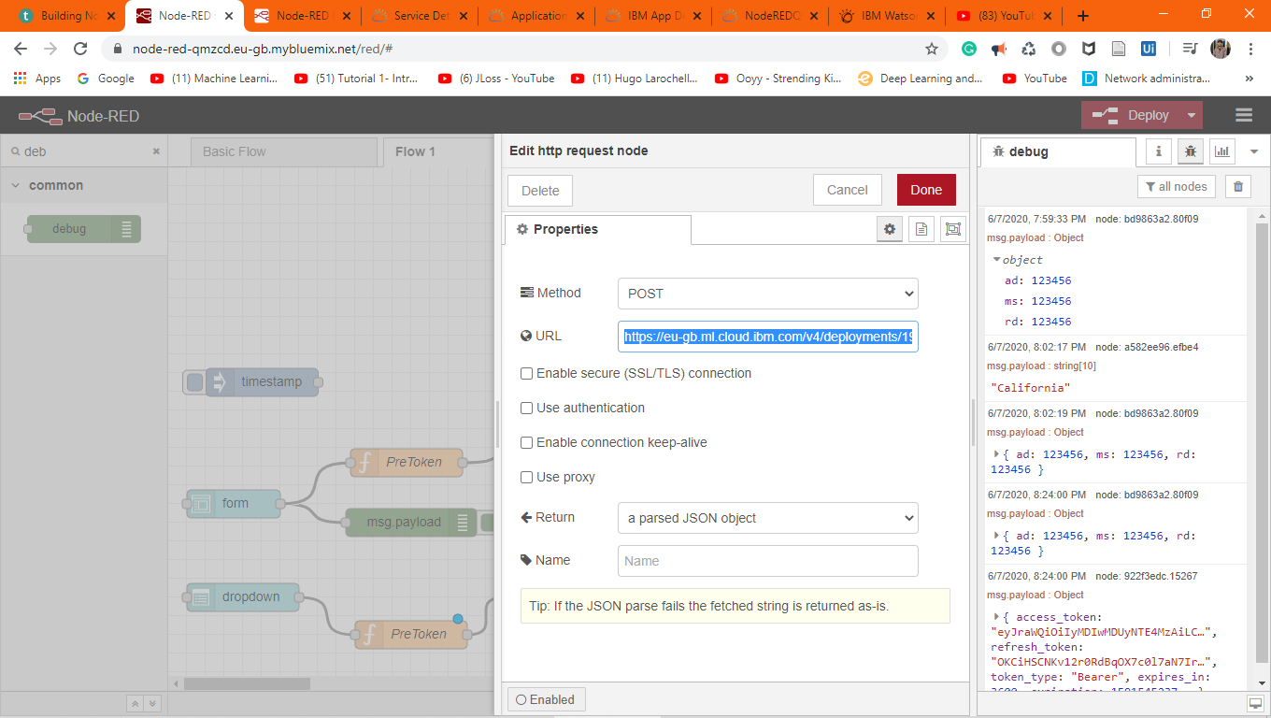

Slide 17
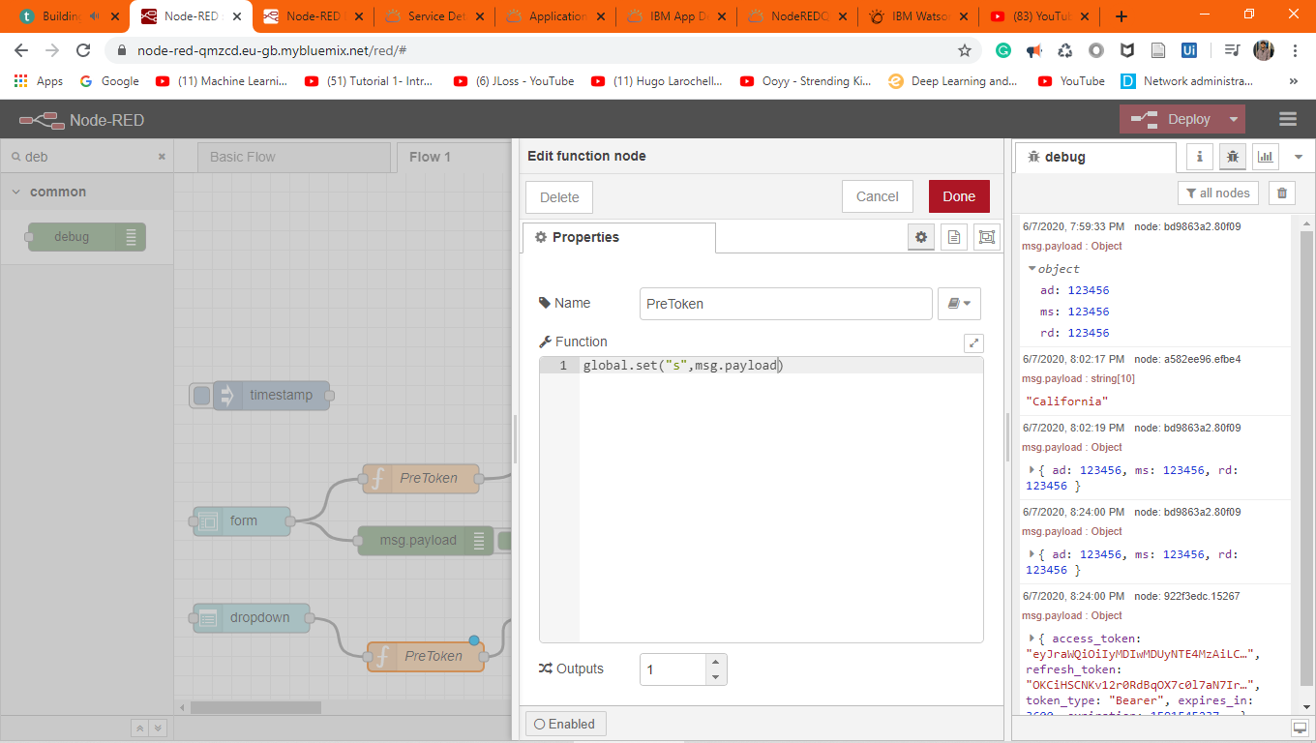
Notes:
One Hot Encoding is not needed as it is handled by the Scoring Function

Slide 18
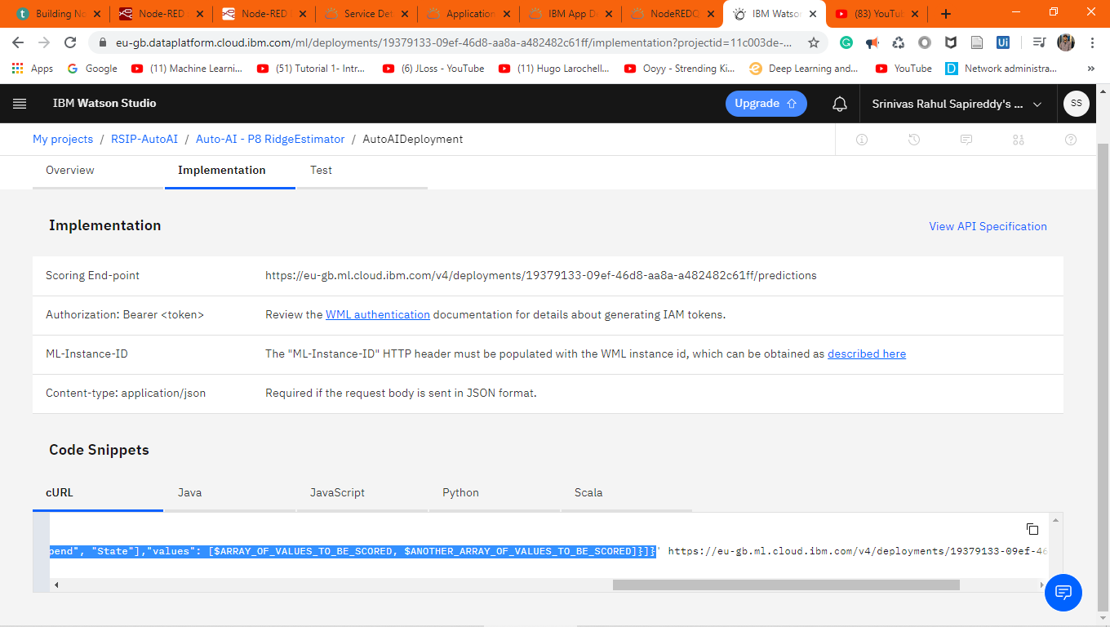
Notes:
We are sending data in this format

Slide 19
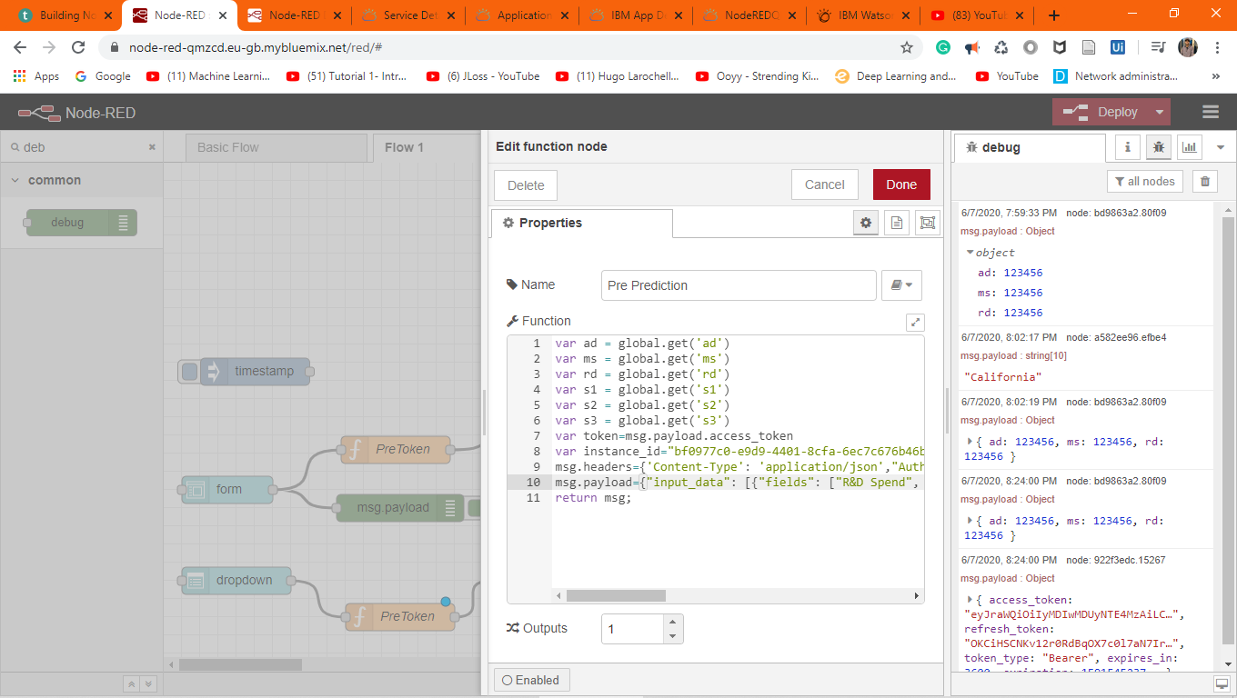
Notes:
Paste it in the payload

Slide 20
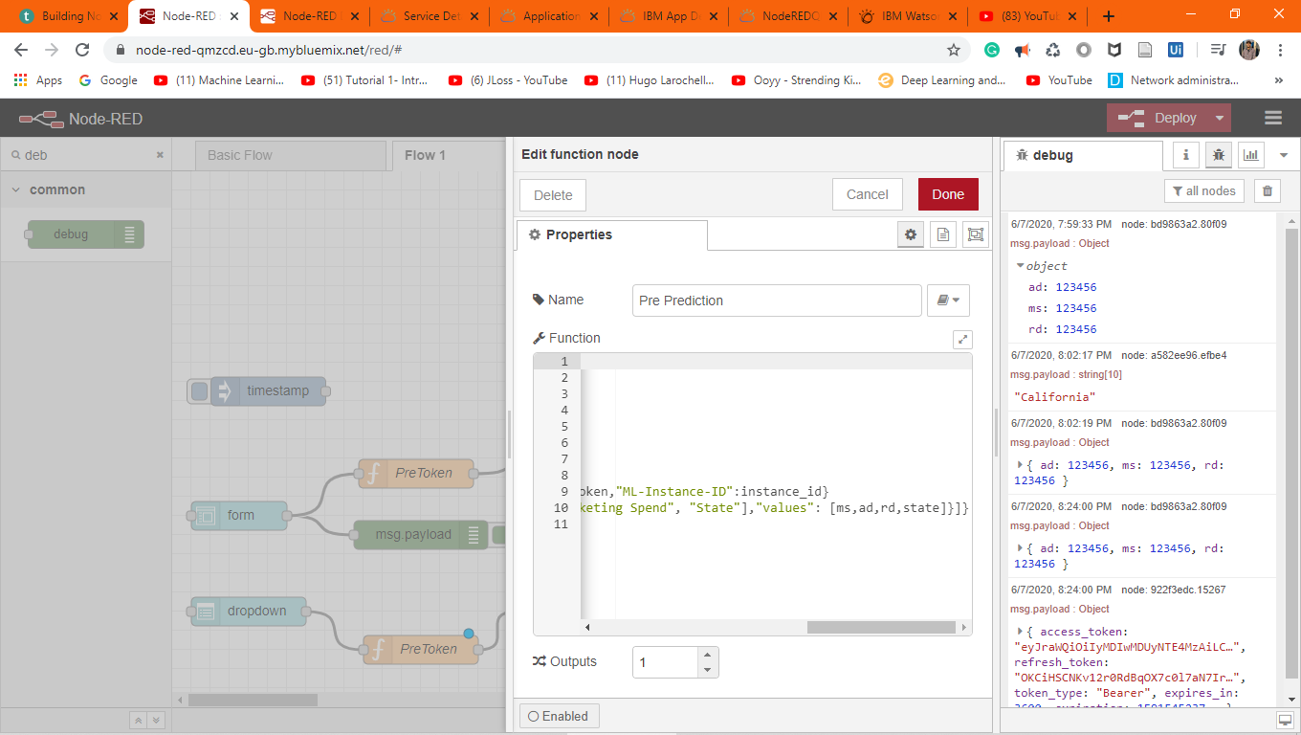

Slide 21
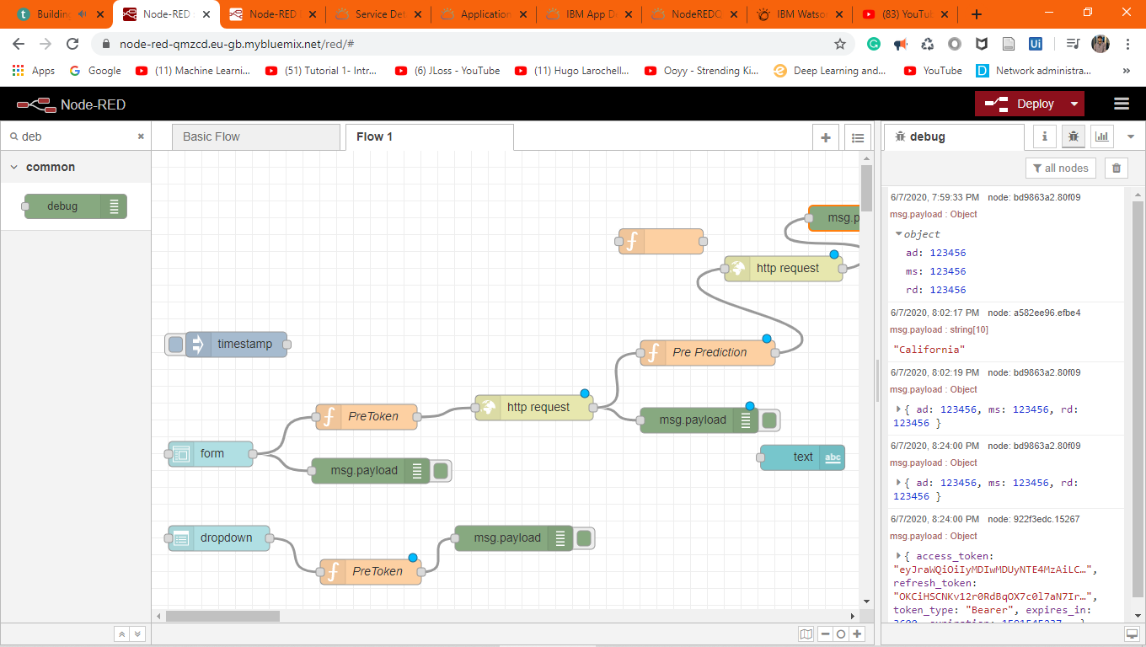

Slide 22
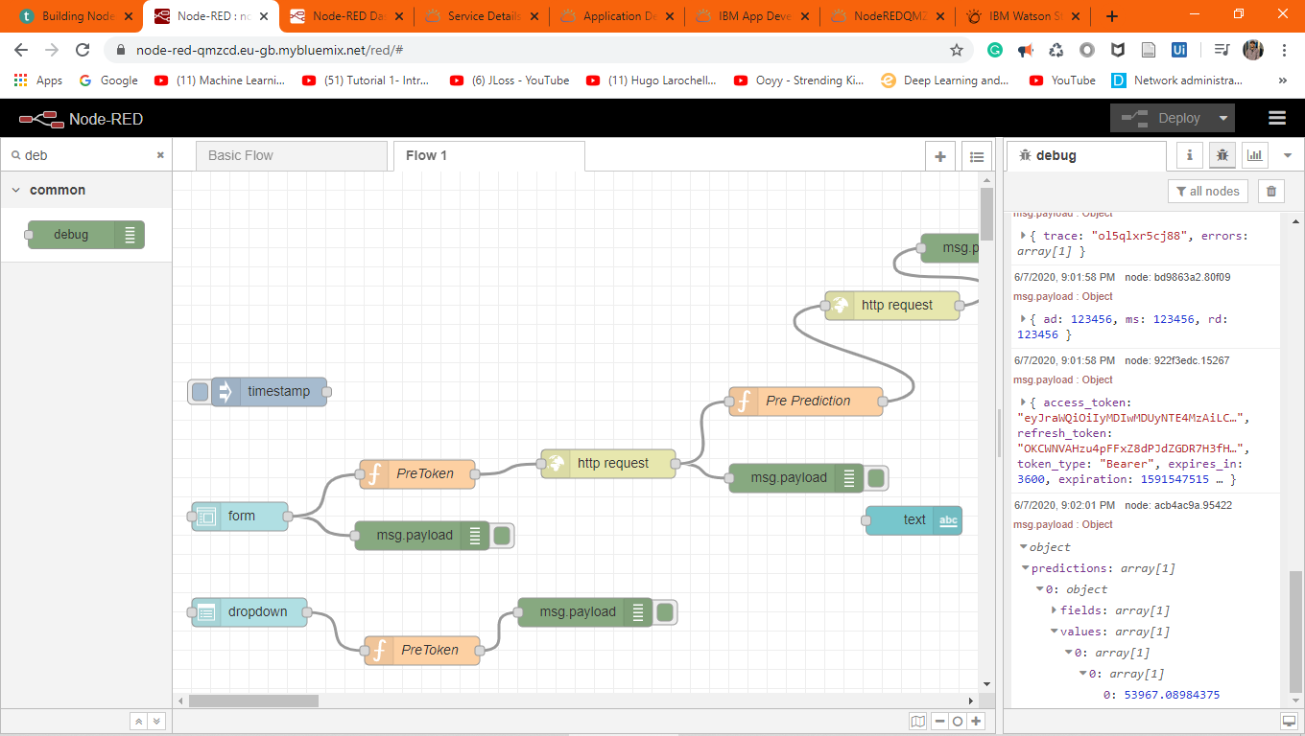

Slide 23
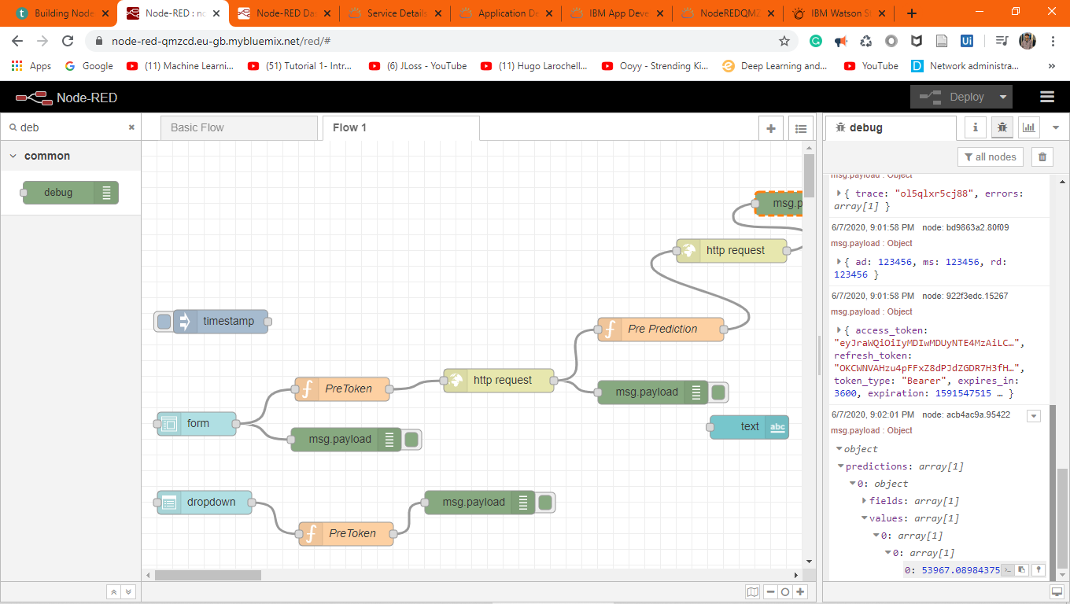
Notes:
payload.predictions[0].values[0][0][0]

Slide 24
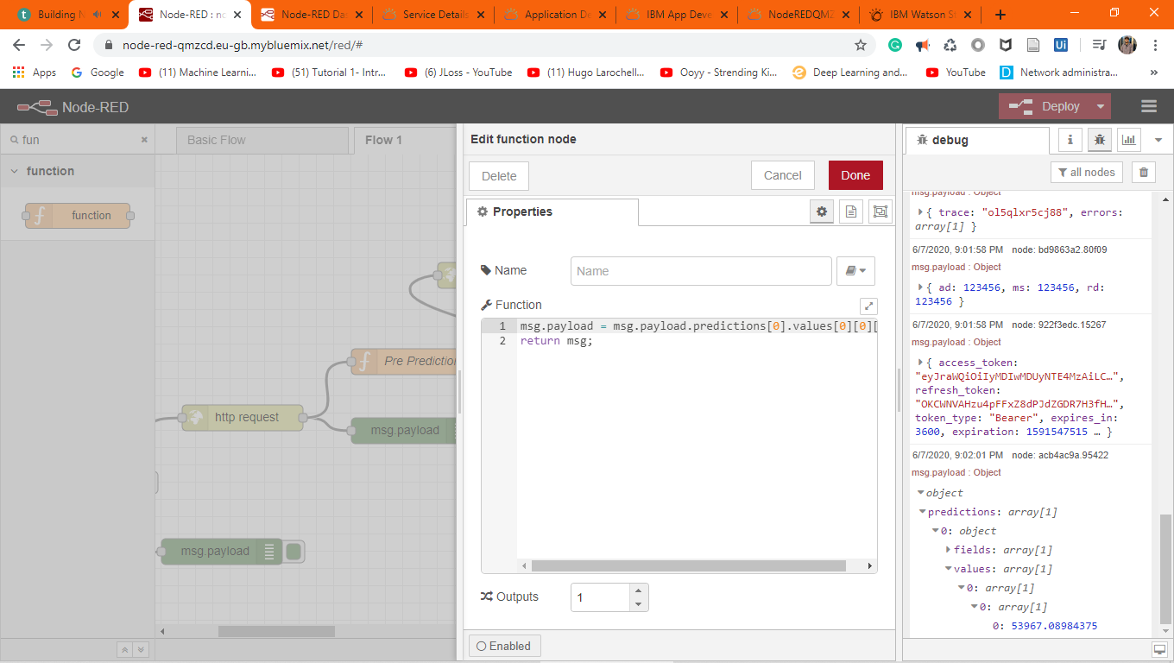
For parsing the data in JSON

Slide 25
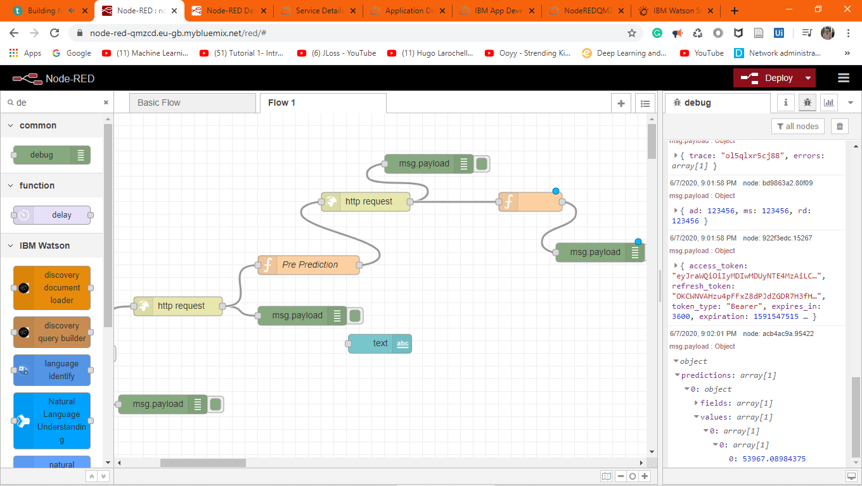

Slide 26
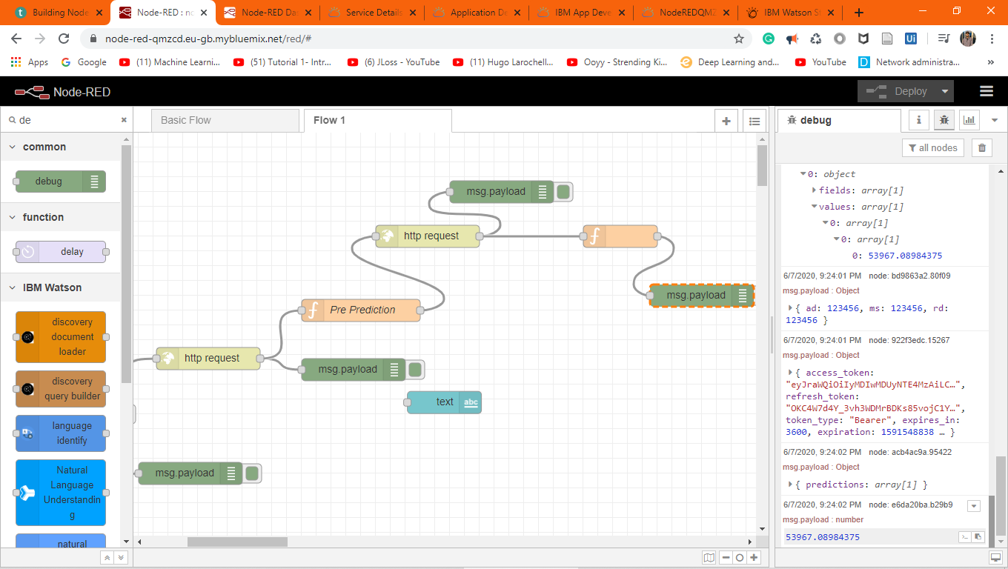

Slide 27
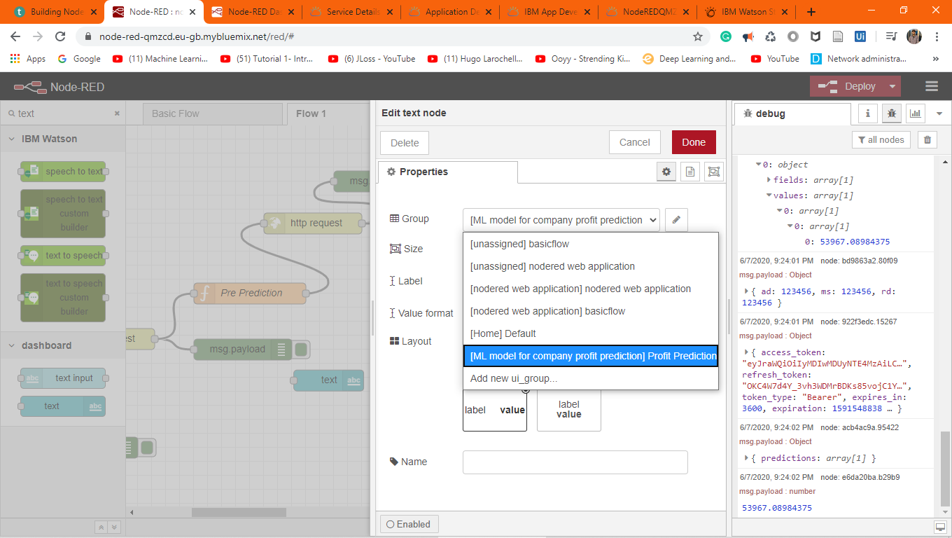

Slide 28
